Slide 1
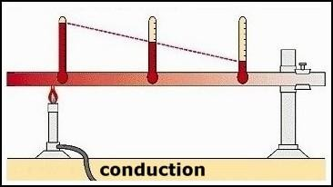
One-Dimensional Steady-State Conduction
We will focus on the one-dimensional steady-state conduction problems
only. It is the easiest heat conduction problem.
In one-dimensional problems, temperature gradient exists along one
coordinate axis only.
Objective
The objective of our analysis is to determine; a) the temperature distribution
within the body and, b) the amount of heat transferred (heat flux).
T₁
T₂
T₃
q_{x}
x

Slide 2
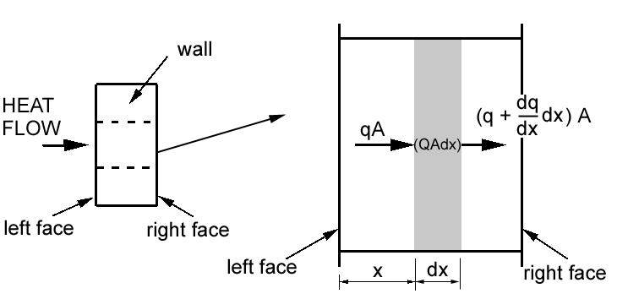
The Governing Equation
Consider heat conduction q (W/m²) through a plane wall, in which there is a
uniform internal heat generation, Q (W/m³).
An energy balance across a control volume (shaded area) yields,
⎛
dq
dx
⎞
qA + QAdx = ⎜ q +
⎝
dx ⎟ A
⎠

Slide 3
q = heat flux per unit area (W/m²)
A = area normal to the direction of heat flow (m²)
Q = internal heat generated per unit volume (W/m³)
Cancelling term qA and rearranging, we obtain,
dq
where
Q =
… (i)
dx
For one-dimensional heat conduction, the heat flux q is governed by the
Fourier’s law, which states that,
q = −k ⋅ ⎛
dT
dx
⎞
⎟
⎜
… (ii)
⎝
⎠
where
k = thermal conductivity of the material (W/m.K)
(dT/dx) = temperature gradient in x-direction (K/m)
Note: The –ve sign is due to the fact that heat flows from a high-temperature to
low- temperature region.

Slide 4
Substituting eq.(ii) into eq.(i) yields,
d
⎛
dT
⎞
⎜ k
⎝
⎟
⎠
+ Q = 0
dx
dx
The governing equation has to be solved with
to get the desired temperature distribution, T.
appropriate boundary conditions
Note:
Q is called a source when it is +ve (heat is generated), and is called a sink when
it is -ve (heat is consumed).

Slide 5
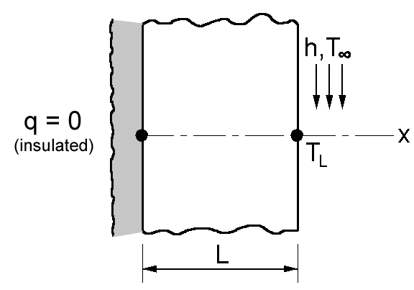
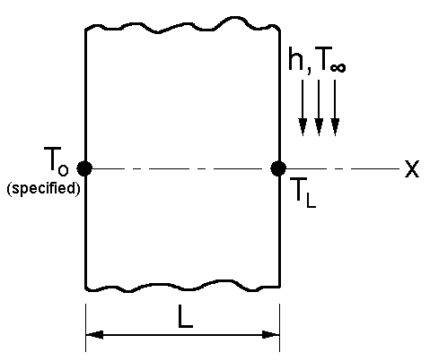
Boundary Conditions
There are three types of thermal boundary conditions:
a) Specified temperature, T_{i} = T_{o};
b) Specified heat flux, e.g., q_{i} = 0 (insulated edge or surface);
c) Convection at the edge or surface, (h & T∞ are specified).
These are illustrated below.
Note: h is the convective heat transfer coefficient (W/m²K)

Slide 6
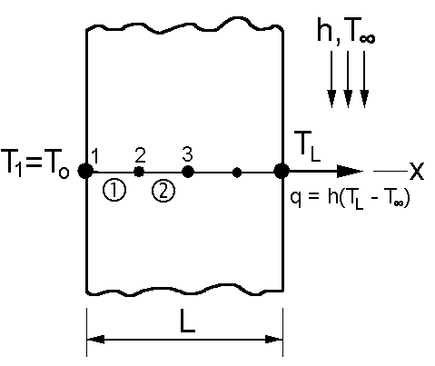
Finite Element Modeling
The uniform wall can be modeled using one-dimensional element.
To obtain reasonably good temperature distribution, we will discretize the wall into several 1-D heat transfer elements, as shown.
Note:
X represents the global coordinate
system.
Can you identify the kind of boundary
conditions present?
There is only one unknown quantity at any given node, i.e. the nodal temperature, T_{i}.

Slide 7
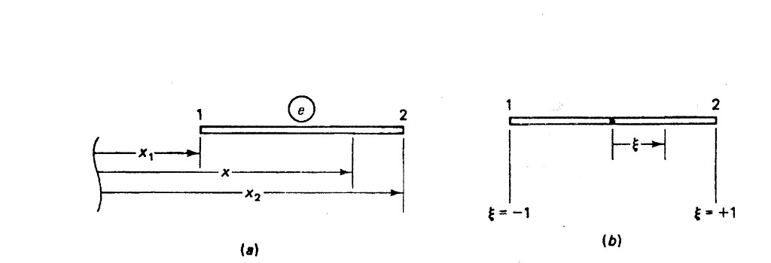
Temperature Function
For a given element in local coordinate (ξ), temperature T varies along the
length of the element.
We need to establish a temperature function so that we can obtain the
temperature T, at any location along the element, by interpolation.
For a one-dimensional steady-state conduction, temperature varies linearly along
the element.
Therefore we choose a linear temperature function given by,
T (ξ ) =
N₁T₁ + N ₂T₂
or
T (ξ ) = [N ]{T}

Slide 8
where N = ¹ (1 − ξ )
1
and N = (1 + ξ )
1
2
2
2
We wish to express the (dT/dx) term in the governing equation in terms of
element length, l_{e}, and the nodal temperature vector, {T}. Using the chain rule of differentiation
dT
dx
dT dξ
dξ dT
=
⋅
dξ dx
=
⋅
dx dξ
(i)
2
) ⁽
₁ )
dξ
dx
2
Recall,
ξ =
x − x −1
⇒
=
…(ii)
( x − x
( x
− x
)
2
1
2
1
1
1
dT
1
1
T (ξ ) = (1 − ξ )T₁ + (1 + ξ )T₂
⇒
= − T₁ + T₂
(iii)
2
2
dξ
2
2
Substitute eq.(ii) and eq.(iii) into eq.(i) we get,
dT
dx
1
(
₂ )
=
− T + T
x₂ − x₁
1

Slide 9
or,
dT
dx
dT
dx
¹ [−1
1]{T }^{e}
=
x₂ − x₁
= [B
]{T }^{e}
T
[B_{T} ] =
1
) ^{[−1}
1
where
1] = [−1
1]
( x − x
l
2
1
e
is called the temperature-gradient matrix. The heat flux, q (W/m²) can then
be expressed as
_{1]} ⎧T₁ ⎫
1
q = −k ⋅ [−1
⎨ ⎬
l_{e}
⎩^{T}2 ⎭

Slide 10
Element Conductivity Matrix
The element conductivity matrix [k_{T}] for the 1-D heat transfer element can be derived using the method of weighted residual approach.
Recall, the conduction governing equation with internal heat generation,
d
⎛
dT
⎞
⎜ k
⎝
⎟ + Q = 0
⎠
dx
dx
Imposing the following two boundary conditions,
= h(T_{L} − T∞ )
T_{x=0}
= T_{o}
and
q_{x=L}
and solving the equation yields the functional, πT given by
L
1
2
k ⎛
dT
dx
⎞
⎟
2
1
∫₀
_{L}
dx − QTdx + h (T
)²
π
=
⎜
∫₀
− T
T
⎝
⎠
2
L
∞

Slide 11
Substitute for dx and (dT/dx) in terms of ξ and {T}^{e},
² dx
x₂ − x₁
^{le} dξ
dξ =
⇒
dx =
dξ =
x₂ − x₁
2
2
= [ N ]{T }^{(e)}
dT
dx
= [B
]{T }^{(e)}
T
and
T
Assuming that heat source Q = Q_{e} and thermal conductivity k = k_{e} are constant within the element, the functional π_{T} becomes
1
2
(e)
⎡ k_{e}l_{e}
⎢
1
T
⎤
(e )
π_{T} =
∑
e
{T
∫
[B_{T} ]
[^{B}T ] ^{dξ} ⎥ {^{T} } } ⁻
⎣
2
−1
⎦
^{⎡ Q}e^{l}e
1
⎤
(e) 1
2
∑ ⎢
∫
[ ^{N} ] ^{dξ} ⎥ {^{T} } ^{+ h} (^{T}L ^{− T}∞ )
e
⎣
2
−1
⎦
2
Note: The first term of the above equation is equivalent to the internal strain
energy for structural problem. We identify the element conductivity matrix,
[k ] =
k_{e}l_{e}
1
[B
]^{T}
[B ]⋅ dξ
∫₋₁
T
2
T
T

Slide 12
Solving the integral and simplifying yields the element conductivity
matrix, given by
k_{e} ⎡
1
−1⎤
[k ] =
(W/m²K)
T
l
⎢−1
1
⎥
⎦
e
⎣
Note: If the finite element model comprises of more than one element, then the
global conductivity matrix can be assembled in usual manner to give
⎡ K₁₁
⎢ ^{K}21
⎢
⎢
K₁₂
^{K}22
K_{1L} ⎤
⎢
⎥
^{K2 L} ⎥
[K =
]
(W/m²K)
T
⎥
⎥
⎣ ^{K}L1
K_{L 2}
...
^{K}LL ⎦

Slide 13
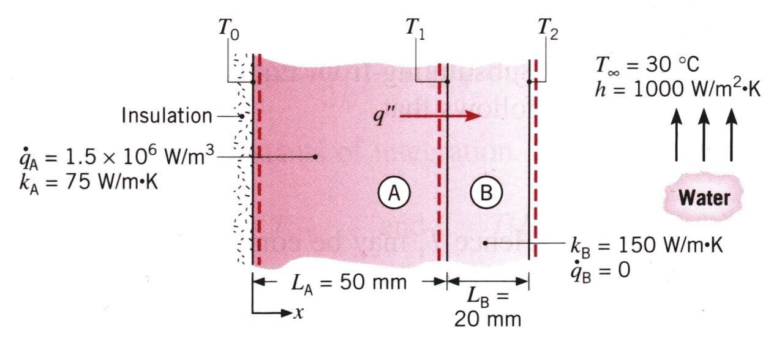
Exercise1
A composite wall is made of material A and B as shown. Inner surface of the wall is insulated while its outer surface is cooled by water stream with T∞ = 30°C and heat transfer coefficient, h = 1000 W/m²K. A uniform heat
generation, Q = 1.5 x 10⁶ W/m³ occurs in material A. Model the wall using two 1-D heat transfer elements.
Question: Assemble the global conductivity matrix, [K_{T}].

Slide 14
Element Heat Rate Vector
If there is an internal heat generation, Q_{e} (W/m³) within the element,
then it can be shown that the element heat rate vector due to the internal heat generation is given by
r
e
Q_{e} ⋅ l_{e} ⎧¹⎫
W
{ _{Q} }
=
⎨ ⎬
2
2
⎩¹⎭
m
Note:
1. If there is no internal heat generation
for that element will be,
in the element, then the heat rate vector
}^{e (0) ⋅ le ⎧1⎫}
⎧0⎫
W
{r
=
=
Q
⎨ ⎬
⎨ ⎬
2
⎩¹⎭ ⎩⁰⎭
m²
2. If there are more than one element in the finite element model, the global heat
rate vector, {R_{Q}} is assembled in the usual manner.

Slide 15
Global System of Linear Equations
The generic global system of linear equation for a one-dimensional
steady-state heat conduction can be written in a matrix form as
⎡ K₁₁
⎢ ^{K}21
⎢
⎢
K₁₂
^{K}22
K_{1L} ⎤
⎧T₁
⎫
⎧ R_{Q1} ⎫
⎢
⎥
^{K2 L} ⎥
⎪ ⎪
⎪
⎪
⎪T₂ ⎪
⎪^{R}Q 2 ⎪
=
⎨ ⎬ ⎨
⎬
⎥ ⎪ ⎪ ⎪
⎪
⎥ ⎪
⎪
⎪
⎪
⎣ ^{K}L1
K_{L 2}
...
^{K} LL ⎦ ⎩^{T}L ⎭
⎩^{R}QL ⎭
Note:
1. At this point, the global system of linear equations have no solution.
2. Certain thermal boundary condition need to be imposed to solve the equations
for the unknown nodal temperatures.

Slide 16
Exercise 2
Reconsider the composite wall in Exercise 6-1. a) Assemble the global
heat rate vector, {R_{Q}}; b) Write the global system of linear equations for the problem.

Slide 17
Temperature Boundary Condition
Suppose uniform temperature T = θ °C is specified at the left side of a plane wall.
To impose this boundary condition, modify the
global SLEs as follows:
T = θ ºC
1
1.
2.
Delete the
1st
row and
1st
column of [KT] matrix;
Modify the {RQ} vector as illustrated.
x
⎡ K₁₁
K₁₂
K_{1L} ⎤
⎧ θ
⎧ ^{R}Q1 ⎫ ⎧ K₁₁θ
L
⎢
⎢ ^{K}
⎢
⎢
⎣ ^{K}
⎫
⎫
⎪ ⎪ ⎪ ⎪ ⎪ ⎪
⎨ ⎬ ⎨ ⎬ ⎨ ⎬
L1 ^{K}L 2 ^{... K}LL ⎦ ⎩^{T}L ⎭ ⎩^{R}QL ⎭ ⎩^{K} L1^{θ} ⎭
K₂₂
⎥
^{K2 L} ⎥
^{⎪T2 ⎪ ⎪RQ 2 ⎪} − ^{⎪ K21θ ⎪}
21
=
⎥ ⎪ ⎪ ⎪ ⎪
⎪ ⎪
⎥ ⎪
⎪
⎪
⎪ ⎪
⎪
Note: Make sure that you use a consistent unit.

Slide 18
Convection Boundary Condition
Suppose that convection occurs on the right side of a plane wall, i.e. at x = L.
The effect of convection can be incorporated by
modifying the global SLEs as follows:
1. Add h to the last element of the [K_{T}] matrix;
2. Add (hT∞) to the last element of {R_{Q}} vector.
We get,
T∞ ;
h
⎡ K₁₁
⎢ ^{K}21
⎢
⎢
K₁₂
^{K}22
K₁
⎤ ⎧T₁ ⎫
⎥ ⎪ ⎪
⎧
⎪
R_{Q1}
^{R}Q 2
⎫
⎪
⎪
x
⎢
L
K₂
⎥ ⎪^{T}2 ⎪
⎪
L
L
=
⎥ ⎨ ⎬ ⎨
⎬
⎥ ⎪
⎪ ⎪
⎪
+ hT∞ )⎪
⎣ ^{K}L1
K_{L 2}
...
( K _{LL}
^{+ h} )⎦
⎪⎩T_{L} ⎪⎭ ⎪( R_{QL}
⎩
⎭
Note: Make sure that you use a consistent unit.

Slide 19
The Heat Flux
Once the temperature distribution within the wall is known, the heat flux
through the wall can easily be determined using the Fourier’s law.
We have,
1
1] ^{⎧T1 ⎫}
q = −k ⋅ [−1
⎨ ⎬
W/m²
l_{e}
⎩^{T}2 ⎭
Note:
1. At steady-state condition, the heat flux through all elements has the same
magnitude.
2. T₁ and T₂ are the nodal temperatures for an element.
3. l_{e} is the element length.

Slide 20
Exercise 3
Reconsider the composite wall problem in Exercise 6-2. a) Impose the
convection boundary conditions; b) Solve the reduced SLEs, determine the nodal temperatures; c) Estimate the heat flux, q through the composite wall.

Slide 21
Heat Flux Boundary Condition
Suppose heat flux q = q_{o} W/m² is specified at the left side of a plane wall, i.e. at x = 0.
The effect of specified heat flux is incorporated into the analysis by modifying the global SLEs, as shown.
q = q₀
⎡ K₁₁
⎢ ^{K}21
⎢
⎢
K₁₂
^{K}22
K_{1L} ⎤
⎧T₁ ⎫
⎪ ⎪
⎧ R_{Q1} ⎫
⎧(−q_{o} )⎫
⎢
⎥
^{K2 L} ⎥
⎪
⎪ ⎪
⎪
⎪T₂ ⎪
^{⎪RQ 2 ⎪} + ⎪
0
⎪
⎬
⎪
=
⎨ ⎬ ⎨
⎬ ⎨
x
⎥ ⎪ ⎪ ⎪
⎪ ⎪
⎪
⎥ ⎪
⎪
⎪
⎪
⎪
⎣ ^{K}L1
Note:
K_{L 2}
...
^{K}LL ⎦ ⎩^{T}L ⎭
⎩^{R}QL ⎭
⎩
0
⎭
L
q0 is input as +ve value if heat flows out of the body and as –ve value if heat is
flowing into the body. Do not alter the negative sign in the global SLEs above.

Slide 22
Exercise 4
Reconsider the composite wall problem in Exercise 6-3. Suppose there is
no internal heat generation in material A. Instead, a heat flux of q = 1500
W/m² occurs at the left side of the wall.
Write the global system of linear equations for the plane wall and impose the specified heat flux boundary condition.
q = 1500 W/m²
k_{A} = 75 W/m ⋅ K

Slide 23
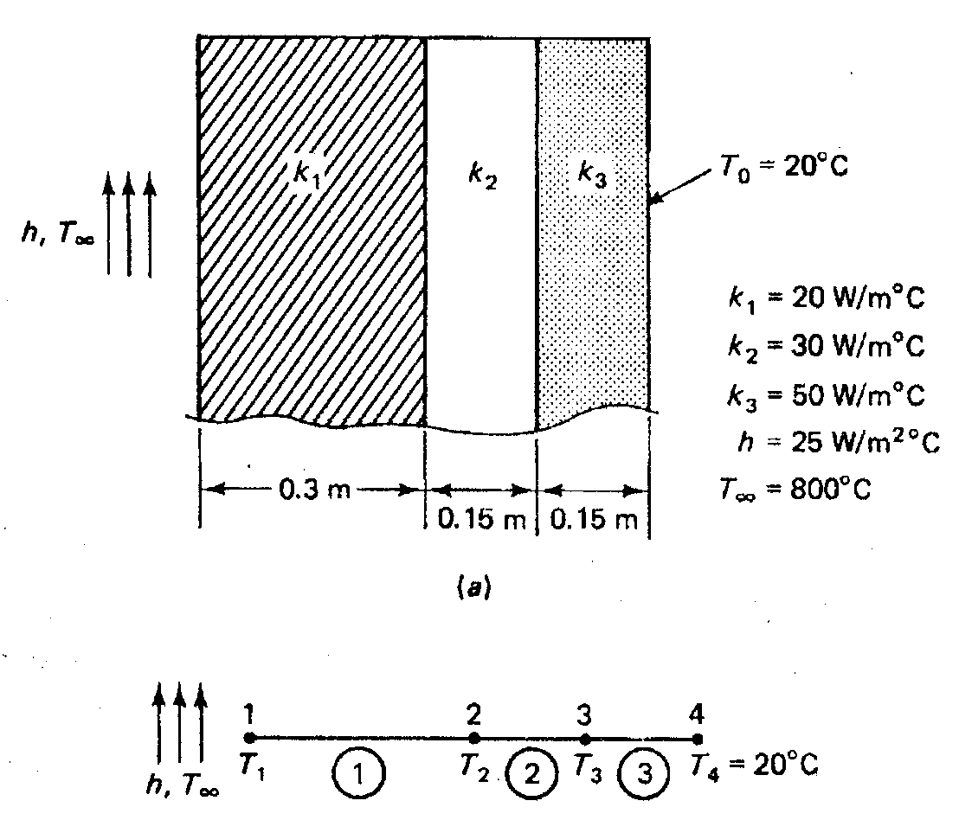
Example 1
A composite wall consists of three
layers of materials, as shown. The ambient temperature is T_{o} = 20 ºC.
Convection heat transfer takes
place on the left surface of the wall
where T∞ = 800
W/m^{2o}C.
ºC
and h = 25
Model the composite wall using
three heat transfer elements and determine the temperature distribution in the wall.

Slide 24
Solution
1. Write the element conductivity matrices
[k
]⁽¹⁾
20
⎡
1 −1⎤
^{W} ;
[k
]⁽³⁾
50 ⎡
1
−1⎤
W
=
0.3 ⎢−1 1
⎥
⎦
=
0.15 ⎢−1
⎥
⎦
T
⎣
m^{2 o}C
T
⎣
1
m^{2 o}C
[k
]⁽ ²⁾
30 ⎡
1
−1⎤
W
=
0.15 ⎢−1
⎥
⎦
T
⎣
1
m^{2 o}C
2. Assemble the global conductivity matrix
⎡
1
−1
4
−3
0
0
−3
8
−5
0
0
⎤
⎥
⎢−1
[K_{T} ] = 66.7 ⎢
⎥
W
⎢
⎢
⎣
0
0
−5⎥
2 o
m C
⎥
⎦
5

Slide 25
3. Write the global system of linear equations
[K_{T} ]{T } = {R_{Q} }
⎡
⎢
66.7⎢
1
− 1
0
0
− 1
4
− 3
0
0
− 3
8
− 5
0
⎤⎧T₁ ⎫ ⎧ R₁ ⎫
⎥⎪ ⎪ ⎪ ⎪
0 ⎪T
⎪
⎪R
⎪
⎥⎨
₂
⎬
=
⎨
₂
⎬
⎢
⎢
⎣
^{− 5⎥}⎪^{T}3 ⎪
⎪^{R}3 ⎪
⎥
⎪⎩^{T ⎪}⎭ ⎪⎩^{R}
5
⎦ 4
4
4. Write the element heat rate vector
Since there is NO internal heat generation, Q in the wall, the heat rate vector
for all elements are
⎧0⎫
{
}¹
{
}²
{
}³
r_{Q}
= r_{Q}
= r_{Q}
=
⎨0⎬
⎩ ⎭

Slide 26
5. Write the global system of linear equations
⎡
1
−1
4
−3
0
0
−3
8
−5
0
0
⎤ ⎧T₁ ⎫
⎥ ⎪ ⎪
⎧0⎫
⎪ ⎪
⎢
66.7 ⎢⁻¹
⎥ ^{⎪T2 ⎪}
⎪0⎪
⎨ ⎬
⎨ ⎬
=
⎢
⎢
⎣
0
0
^{−5⎥} ⎪^{T}3 ⎪
⎪⁰⎪
⎥ ⎪
⎪ ⎪ ⎪
5
⎦ ⎩^{T}4 ⎭
⎩⁰⎭
6. Impose convection and specified temperature boundary conditions (T₄ = 20°C)
results in modified system of linear equations
⎡
⎢
⎢ 0 −3 8 −
⎢
⎥ ⎪ ⎪ ⎪ ⎪
⎨ ⎬ ⎨ ⎬
⎥ ⎪ ⎪ ⎪ ⎪
⎡1.375
−1
4
0
−3
0
0
⎤ ⎧T₁ ⎫ ⎧
(25 × 800)
0
⎫
⎪
66.7 ⎢
−1
⎥ ^{⎪T2 ⎪ ⎪}
=
^{5⎥} ⎪^{T}3 ⎪
⎪^{0 − (−5 × 66.7) × 20}⎪
⎣
0
0
−5
5
⎦ ⎩^{T}4 ⎭ ⎩
0
⎭

Slide 27
7. Solving the modified system of linear equations yields
⎧T₁ ⎫
⎧304.6⎫
⎪ ⎪ ⎪
⎪
⎪T₂ ⎪
⎪119.0 ⎪
=
ºC
⎨ ⎬ ⎨
⎬
⎪
⎪⎭
⎪^{T}3 ⎪ ⎪
57.1
20.0
⎪⎩^{T}4 ⎪⎭
⎪⎩

Slide 28
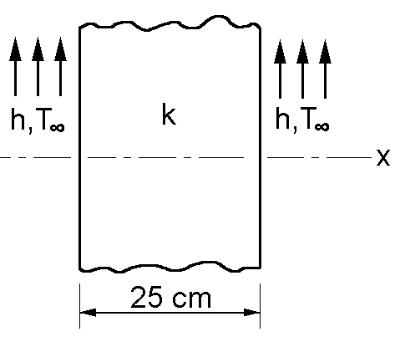
Example 2
Heat is generated in a large plate (k = 0.8 W/mºC) at a rate of 4000 W/m³.
The plate is 25 cm thick. The outside surfaces of the plate are exposed to
ambient air at 30ºC with a convection heat transfer coefficient of 20 W/m^{2o}C.
Model the wall using four heat transfer elements and determine: (a) the temperature distribution in the wall, (b) heat flux, and (c) heat loss from the right side of the wall surface.
Data:
W
k = 0.8
m º C
W
h = 20
m º C
T = 30 º C
∞

Slide 29
Solution
The finite element
model for
the plane
wall
is shown below.
h, T∞
T1
1
T2
2
T3
3
T4
4
T5
x
1
2
3
4
5
h, T∞
1. Element conductivity matrices.
Since the element length and thermal conductivity are the same for all elements,
we have
⎡
12.8
−12.8⎤
W
[k
]⁽³⁾
⎡
12.8 −12.8⎤
W
[k
]⁽¹⁾
=
=
⎢−12.8 12.8
⎥
⎦
T
⎢−12.8
12.8
⎥
⎦
m^{2 o}C
T
⎣
m^{2 o}C
⎣
]⁽ ²⁾
⎡
12.8
−12.8⎤
W
[k
]⁽ ⁴⁾
⎡
12.8 −12.8⎤
W
[k
=
⎢−12.8
⎥
⎦
=
⎢−12.8 12.8
⎥
⎦
T
⎣
12.8
m^{2 o}C
T
⎣
m^{2 o}C

Slide 30
2. Assemble the global conductivity matrix,
1
12.8
2
−12.8
25.6
−12.8
0
0
3
0
−12.8
25.6
−12.8
0
4
0
0
−12.8
25.6
−12.8
5
0
0
⎡
⎤
⎥
⎥
⎢−12.8
⎢
⎢
⎢
[K_{T} ] =
0
0
0
⎥
−12.8⎥
⎢
⎥
⎢⎣ 0
12.8
Note: Connectivity with the global
node numbers is shown.

Slide 31
3. Heat rate vector for each element
Since the magnitude of internal heat generation and length of all
elements are the same, we have
{r
}⁽¹⁾
4000 × 0.0625 ⎧1⎫
⎨ ⎬
⎧125⎫
⎩125⎭
⎧125⎫
⎩125⎭
⎧125⎫
⎩125⎭
⎧125⎫
⎩125⎭
=
=
⎨
⎬
Q
2
⎩¹⎭
4. Assemble the global heat rate
vector, we get
{r
}⁽ ²⁾
4000 × 0.0625 ⎧1⎫
⎨ ⎬
=
=
⎨
⎬
⎧125 ⎫
⎪250⎪
Q
2
⎩¹⎭
4000 × 0.0625 ⎧1⎫
⎨ ⎬
⎪
⎪
W
{r
}⁽³⁾
{R } = ⎪250⎪
=
=
⎨
⎬
Q
⎨
⎬
Q
2
⎩¹⎭
⎪
⎪
m
2
⎪²⁵⁰⎪
⎪⎩¹²⁵
{r
}⁽ ⁴⁾
4000 × 0.0625 ⎧1⎫
⎨ ⎬
=
=
⎨
⎬
Q
2
⎩¹⎭

Slide 32
5. Write the system of linear equation,
[K_{T} ]{T } = {R_{Q} }
⎡
12.8
− 12.8
25.6
− 12.8
0
0
0
− 12.8
25.6
− 12.8
0
0
0
− 12.8
25.6
− 12.8
0
0
0
⎤⎧T₁ ⎫
⎥⎪T ⎪
⎧125⎫
⎪250⎪
⎢− 12.8
⎢
⎢
⎢
⎥⎪
² ⎪
⎪
⎪
0
0
⎥⎨T₃ ⎬
= ⎨250⎬
⎥⎪T
⎪ ⎪
⎪
⎢
^{− 12.8}⎥⎪
⎪²⁵⁰⎪
⁴ ⎪
⎢⎣ 0
12.8
⎥⎦⎪⎩^{T}5
⎪⎭ ⎪⎩¹²⁵
6. Impose convection boundary conditions
on both sides of the wall,
⎡12.8 + 20
− 12.8
25.6
− 12.8
0
0
0
− 12.8
25.6
− 12.8
0
0
0
− 12.8
25.6
− 12.8
0
0
0
− 12.8
⎤⎧T₁ ⎫
⎧125 + 20(30)⎫
⎢
⎢
⎢
⎢
− 12.8
0
0
⎥⎪T ⎪ ⎪
250
250
250
⎪
⎪
⎬
⎪
⎥⎪
² ⎪
⎪
⎥⎨T₃ ⎬ ⎨
=
⎥⎪T
⎪ ⎪
⎢
⎥⎪
⁴ ⎪
⎪
⎪
⎢⎣ 0
12.8 + 20
⎥⎦⎪⎩T5
⎪⎭ ⎪⎩125 + 20(30)

Slide 33
7.
Solving the modified system of linear equations by using Gaussian
elimination method, we obtain the temperatures at the global nodes
as follows,
⎧T₁ ⎫
⎪ ⎪
⎧55.0⎫
⎪^{T2} ⎪
⎪
⎪
⎪^{84.3}⎪
⎪ ⎪
⎪
⎪
º C
T = 94.0
⎨ 3 ⎬ ⎨
⎬
⎪_{T} ⎪
4
⎪84.3⎪
⎪ ⎪
⎪⎩^{T}5 ⎪⎭
⎪
⎪
⎪⎩^{55.0}⎪⎭
h, T∞
T1
T2
T3
T4
T5
x
1
2
3
4
5
h, T∞
Note: Notice the symmetry of
the temperature distribution.

Slide 34
8.
Compute the heat flux and heat loss.
a) Heat flux through the wall
Consider the
4th
element. Using the Fourier’s law, we have
1
1] ^{⎧T1 ⎫}
q = −k ⋅ [−1
⎨ ⎬
l_{e}
⎩^{T}2 ⎭
The heat flux through the
wall is not constant due to the heat generation Q that occurs in the wall.
q = −0.8 ⋅ ¹ [−1
1] ^{⎧84.3⎫}
⎨
⎬
0.0625
W
⎩^{55.0}⎭
q = 375
m²
b) Heat loss from the right side of the wall, per unit surface area.
Using the Newton’s law of cooling, we have
W
q = h (T
− T = 20 × (55 − 30) = 500
)
wall
∞
m
2

